Slide 1
OpenMP Target Constructs Behind C++ Templates
Experiences of the PIConGPU CAAR application using Alpaka
Computational Science Department · Guido Juckeland · g.Juckeland@hzdr.de · www.hzdr.de/fwcc

Slide 2
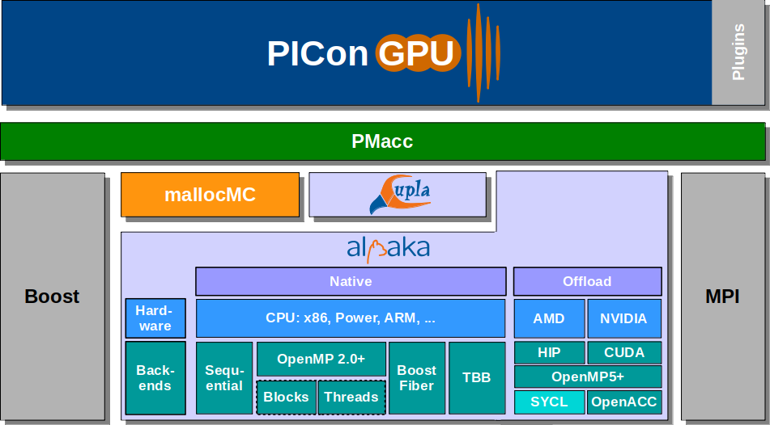
PIConGPU Full Software Stack
template< typename T_Acc >
ALPAKA_FN_ACC void operator()(
T_Acc const & acc,
// ...
) const
{
// ...
}
Huebl, Axel, et al. (2018) Zero Overhead Modern C++ for Mapping to Any Programming Model. Software Stack updated by René Widera (2020)

Slide 3
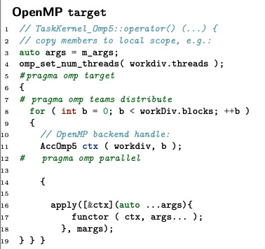
What is ?
Header-only C++14 abstraction library for accelerator development
Accelerator type passed to device kernels as backend handle
template<typename TAcc>
void kernel(const TAcc& acc, ...);
⇒ no conditional compilation required for backend selection
API and feature set modelled after CUDA host devices, queues, events, memory management, ... device atomics, block-shared memory, block-sync, ... lib math, random, ...
supported backends include: sequential, OpenMP, TBB, CUDA, HIP, ...

Slide 4
Issues in Standards
types containing static constexpr data members were not mappable (OpenMP target (< 5.0) )
probably result of a ban on static with no regard to const in C++
mapping of constexpr variables with static lifetime (compile-time constants) not implicit (OpenMP target)
compiler knows which constants are used and there is no abiguity about sequence of copy ⇒ should be implicit
std::tuple implementations are not required to be trivially copyable if all component types are (C++)
⇒ no std::tuple is formally mappable

Slide 5
Issues with Compilers
Main complication turned out to be a lack of tested compiler support:
OpenMP 5.0 not fully supported anywhere. E.g: GCC types with static constexpr not mappable (very strict interpretation of OpenMP 4.5) ⇒ porting PIConGPU impossible
Internal Compiler Errors (ICE) happen when directives meet C++
Invalid use or not-implemented features can trigger ICE instead of compiler error
Runtime errors, like incorrect data sharing, atomics not doing what they should

Slide 6
What runs now?
Test suite
Suite of tests also used in alpaka’s CI
Battery of test cases for each aspect of a backend: kernels, memory, atomics, ...
Using Catch2 ⇒ more TMP, harder for compilers to succeed.
PIConGPU compiles and runs using Clang Main on x86

