Slide 1
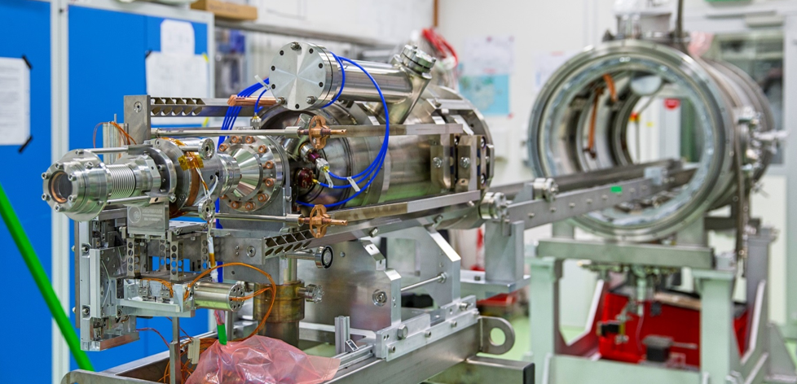
The application of deep learning on slit-scan images processing and emittance prediction
Shuai Ma, Andre Arnold, Anton Ryzhov, Jana Schaber, Murcek Petr, Zwartek Paul, Jochen Teichert, Rong Xiang
17th March 2021, DPG 2021, Dortmund
Shuai Ma | Institute of Radiation Physics | www.hzdr.de

Slide 2
Contents
Motivation
Traditional method limitation
Deep learning models
Images classification based on CNN
Auto-encoder filter in images data processing
Emittance prediction based on point cloud network
Summary
2/12
DPG Spring meeting 2021, Dortmund
Shuai Ma | Institute of Radiation Physics | www.hzdr.de

Slide 3
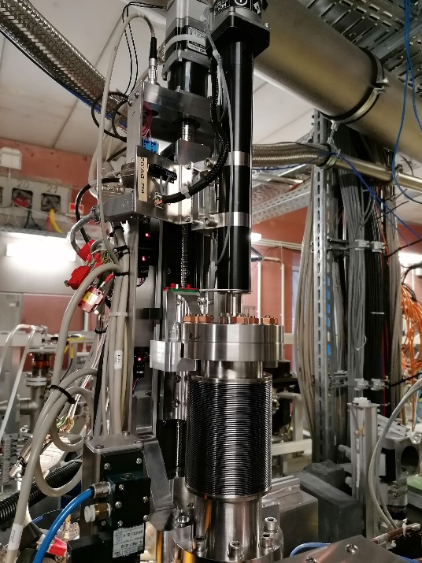
Motivation
MQ.01
MQ.02
MQ.03
YAG screen
Thermionic injector
accelerator module 1
chicane
SRFgun II
dump
YAG screen 3
energy measurement
MS.08
slit mask
YAG screen 2
solenoid
Quad. 01
Quad. 02
Quad. 03
dump
The radiation source ELBE (Electron Linac for beams with high Brilliance and low Emittance) delivers multiple secondary beams, both electromagnetic radiation and particles. To measure beam emittance effectively before user time, a fast and accurate method, the continue moving slit scan system for high bunch charge has been developed.
Fast motor + single slit + screen + camera
3/12
DPG Spring meeting 2021, Dortmund
Shuai Ma | Institute of Radiation Physics | www.hzdr.de
Notes:
This is the experiment beamline. The ELBE radiation source is a user facility with two injectors. The slit-scan if for the SRF Gun beamline, with a single slit mask, a fast motor and a screen and camera.
Usually hundreds of images will be analysis in one experiment and it takes about one or more minutes. The main analysis work is to filter the noise and calculate beamlet rms size.

Slide 4
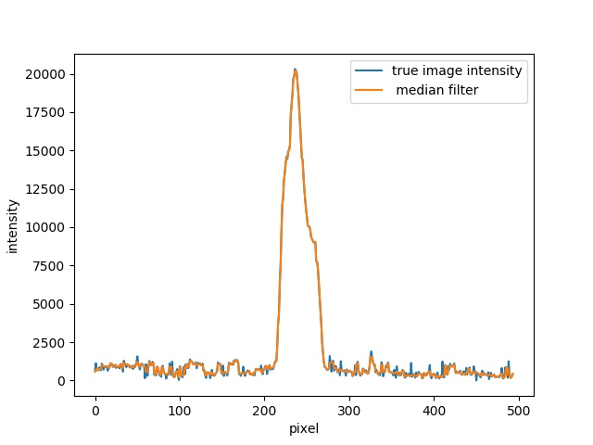
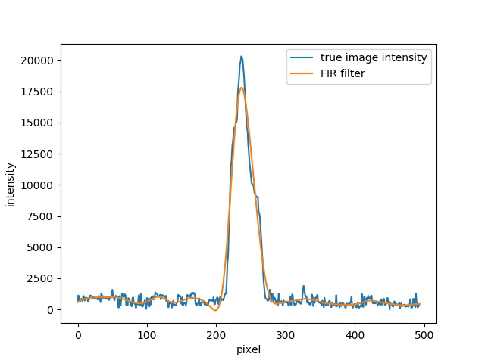
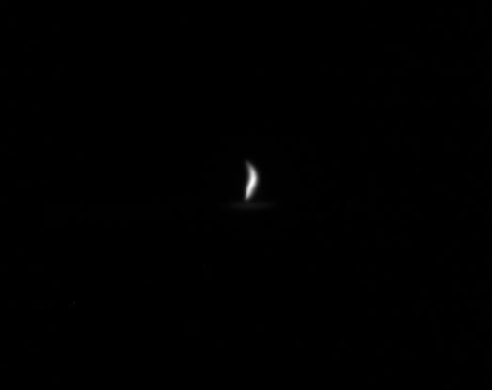
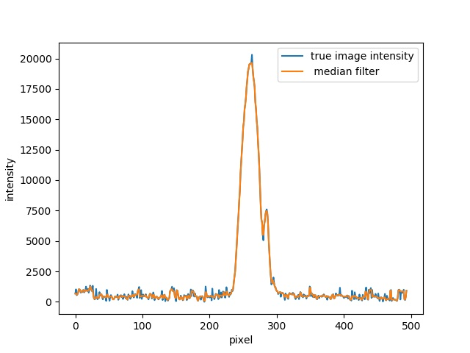
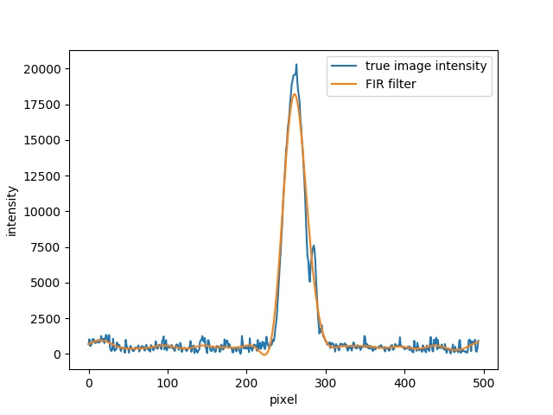
Traditional method limitation
Beamlet intensity distribution uncertain and background is changeable. Traditional filter only smooth the distribution.
Original image
Vertical projection and median filter
FIR filter
4/12
DPG Spring meeting 2021, Dortmund
Shuai Ma | Institute of Radiation Physics | www.hzdr.de
Notes:
There are a lot of traditional noise filters, for example median and FIR. Here are two experiment images, and project the images in vertical direction to have the beamlet 1d intensity distribution.
There are some noise beside the real beamlet. It will increase the rms size and then increase the calculated emittance. As you see, the traditional filters is just smooth the noise rather than decreasing the noise.

Slide 5
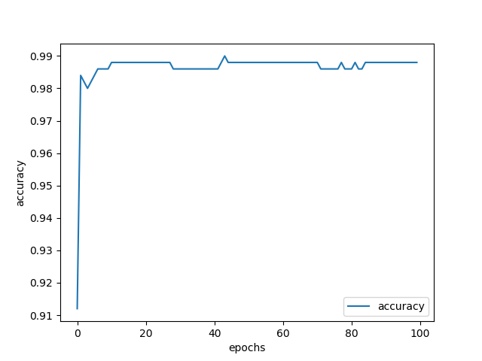
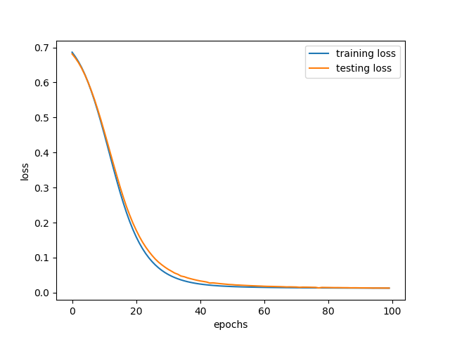
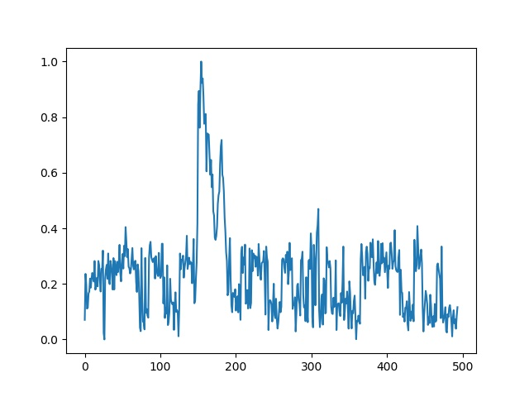
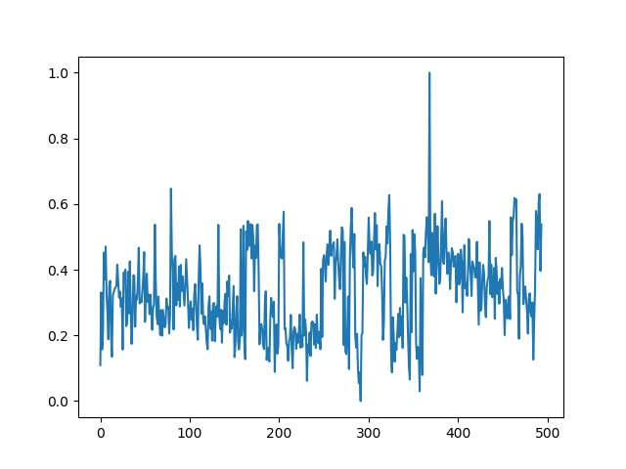
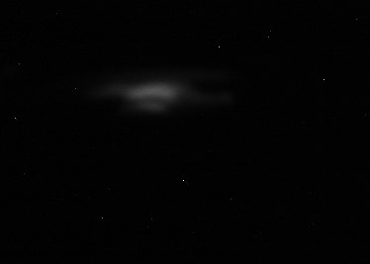
Images classification Convolutional Neural Network (CNN)
Architecture
Image input
Training and testing
Training cases: 2000; testing cases: 500
Two Convolution layers
+
One linear layers
The negative log likelihood loss: $loss\left(x,class\right)=−log\left(\frac{exp⁡(x_{class})}{\sum_{j}{exp⁡(x_{j})}}\right)$
Accuracy: 98.8%
signal
noise
5/12
DPG Spring meeting 2021, Dortmund
Shuai Ma | Institute of Radiation Physics | www.hzdr.de

Slide 6
Auto-encoder filter in images data processing
Architecture
input
x
Input | Operator | c | s
494 x 1 | conv1d | 32 | 2
245 x 32 | conv1d | 64 | 2
128 x 64 | conv1d | 32 | 1
244 x 32 | conv1d | 1 | 1
484 x 1 | linear | 1 | 1
Encoder
$$f_{m→k}$$
latent features
$$h_{k}$$
Decoder
$$f_{k→m}$$
output
y
Loss function:
$$MSELoss= \frac{1}{N}{(x −y)}^{2}$$
6/12
DPG Spring meeting 2021, Dortmund
Shuai Ma | Institute of Radiation Physics | www.hzdr.de
Notes:
In machine learning, sparse auto-encoder is a good network to filter noise. Then I design a simple 1d auto-encoder network structure. It has two parts: encoder layers and decoder layers.
As you see in the figure: The encoder layers with two convolution layers will find the feature of the input data, saying latent features. The decoder layers with two opposite convolution layers and one linear layer will
rebuild the signal. The loss function is a classical one MSELoss function.

Slide 7
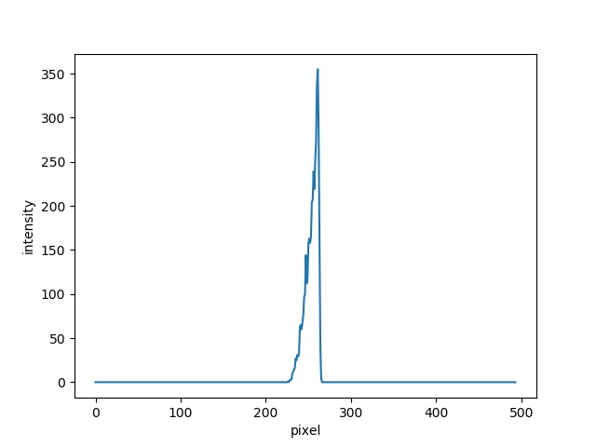
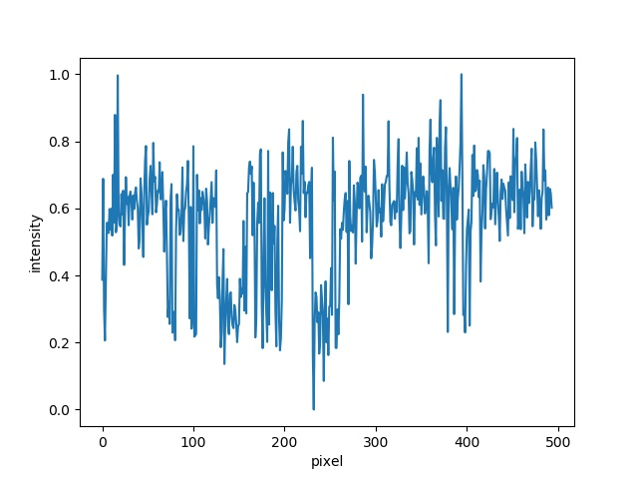
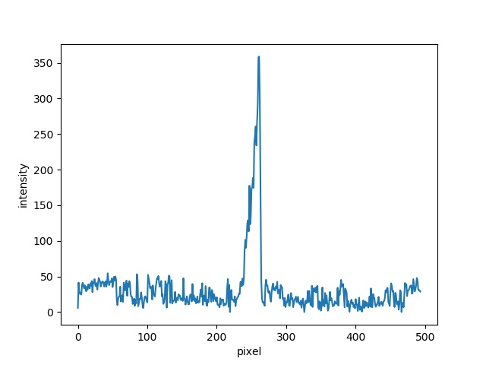
Dataset
Slit scan Astra simulation
Steps:
1. Total particles number: 100,000 ;
2. Cut beam into beamlet, slit width 100 um, step 10 um;
3. All beamlet particles are used as input particles to the next drift space simulation(slit to screen);
4. Record and plot every beamlet particles position at screen position as images from camera;
5. Calculate and rebuild beam phase space at slit position ;
6. Compare calculation results with original emittance.
Noise data is from experiments with 100 images and random selection to add into beamlet (10% amplitude).
Simulated intensity
Real normalized noise
Simulated intensity + 10% noise
7/12
DPG Spring meeting 2021, Dortmund
Shuai Ma | Institute of Radiation Physics | www.hzdr.de
Notes:
To generate the cases, we make a program based on astra software to simulate the slit scan. From the simulation we can obtain the pure signal from the beam. Then one hundred images with random noise
from camera are captured. We add the noise with 10% amplitude into the real signal.

Slide 8
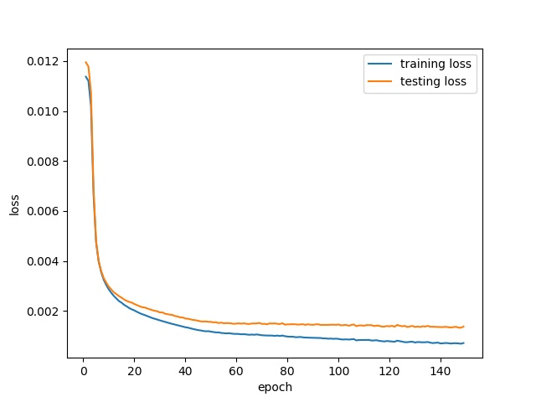
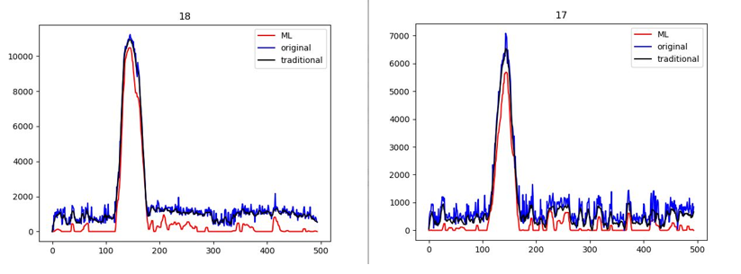
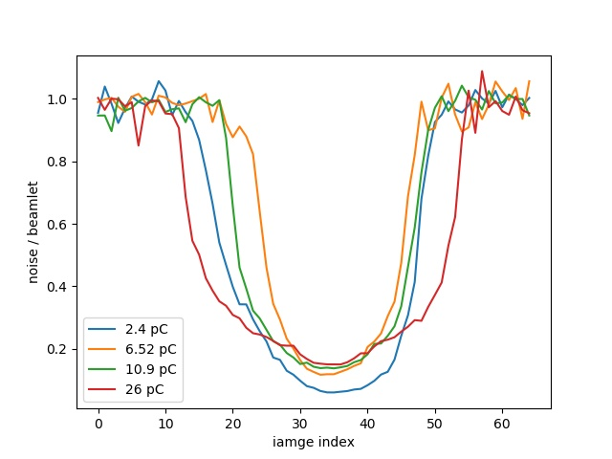
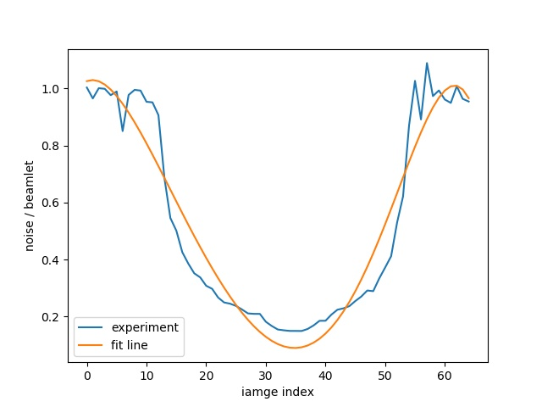
Training and testing
Total cases: 2400; 80% for training and 20% for testing.
Training time ~30 minutes in PC. 100 images processing in 5 seconds. In output, if the intensity is negative values, it will be set to zero.
To test the series of images of calculating emittance, the noise-signal ratio of every image is made and will add into images as their sequence.
8/12
Image index
Image index
DPG Spring meeting 2021, Dortmund
Shuai Ma | Institute of Radiation Physics | www.hzdr.de
Notes:
In the training, 2400 images are used, 80% for training and 20% for testing. It works fast, in my personal computer, it takes around 30 minutes for the whole training. From the loss during the training and testing,
Although the training loss is decreasing around 0.1%, the test loss is stable, 0.15%, when the epoch increase. The model after training is used in real images, it will take 5 seconds for one hundred images. From these
two images, comparing the effectivity of traditional filter and ml filter. The ml filter can reduce the noise effectively. Then I test in one series images of slit-scan. But the first thing has to make is to add noise for these
images. I analysis the factor of noise over the signal and fund a U function of this factor distribution. So I add noise as this function.

Slide 9
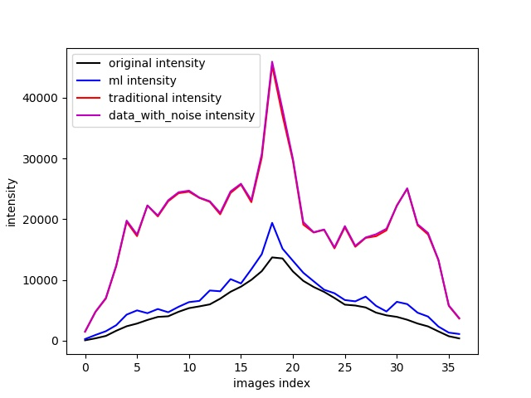
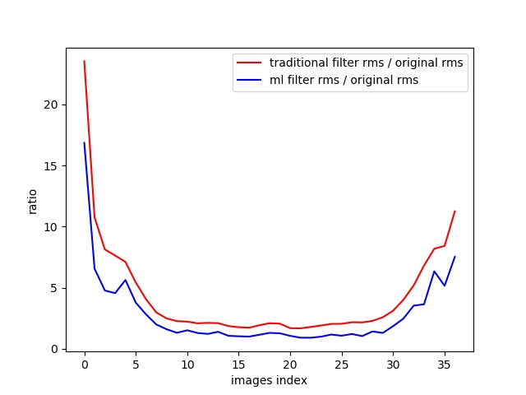
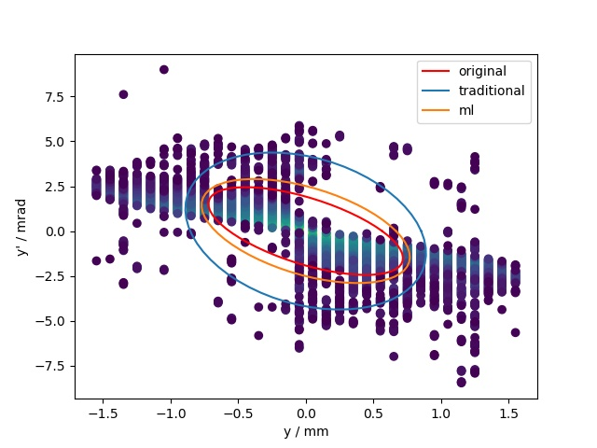
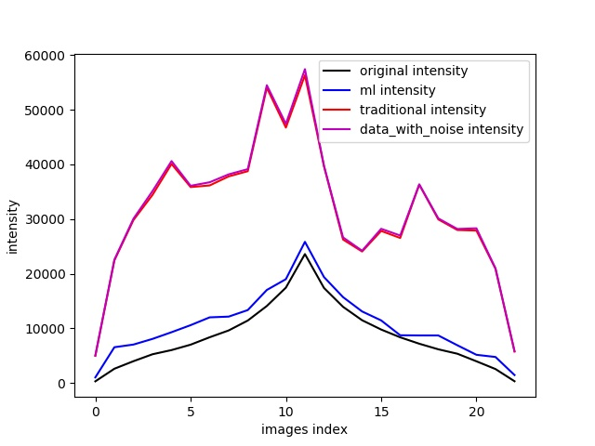
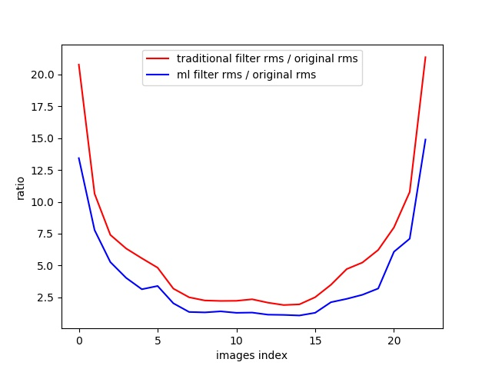
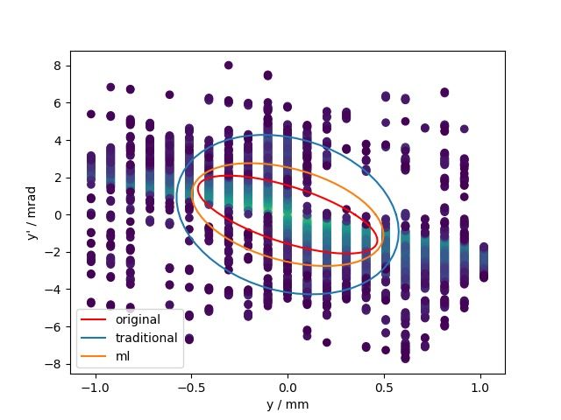
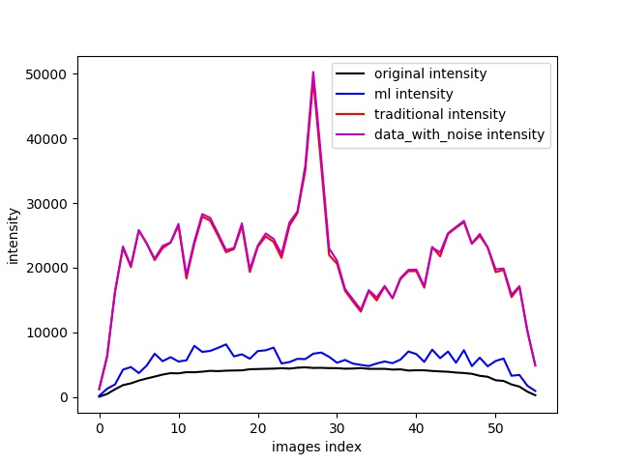
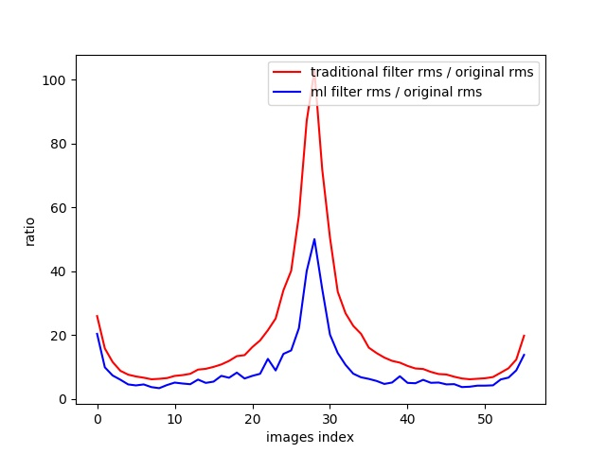
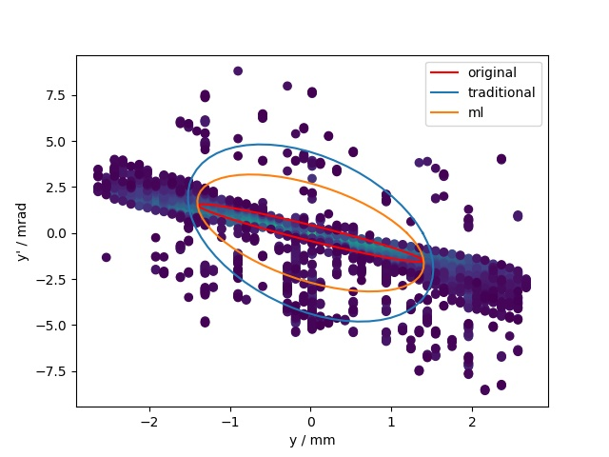
Rms and emittance comparison
Original emittance: 11.95 um
Traditional emittance : 32.63 um
ML emittance : 16.98 um
Original emittance: 6.33 um
Traditional emittance : 21.2 um
ML emittance : 11.01 um
Original emittance: 5.25 um
Traditional emittance : 58.15 um
ML emittance : 31.5 um
9/12
Image intensity
beamlet rms
Phase space
Notes:
Here are three examples for the emittance calculation. I compare for parts, the first part is the image intensity, after the ml filter, the noising images intensity is really close to the real intensity. The traditional
filter is worse. But for images rms size, it still has big influence from the left noise. Usually it happens in sides, but sometimes it happens also in the middle. From the phase space it is more obvious to see that
the ellipses are bigger than the theory. From the area the emittance from ml is about 50% larger and from traditional is about two times.

Slide 10
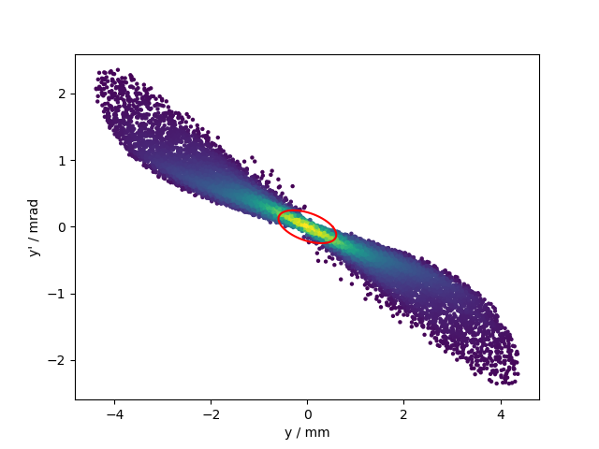
Emittance prediction based on point cloud network
Data set
67% particles are included in rms emittance ellipse. In one case, the $2048$points in phase space with high intensity are selected and add noise like autoencoder network.
Architecture
mlp (64 x 64)
mlp (64 x 128 x 1024)
max
pool
Mlp
(512, 256, 1)
Input points
$$n×3$$
Input transform
$$n×3$$
$$n×64$$
feature transform
$$n×64$$
shared
shared
n x 1024
global feature
regression
output scores
point features
T-Net
3 x 3
transform
T-Net
64 x 64
transform
$$n×128$$
Matrix
multiply
Matrix
multiply
n x 1088
shared
shared
n x m
mlp (512 x 256 x 128)
mlp (128, m)
Qi, C. R., Su, H., Mo, K., & Guibas, L. J. (2017). Pointnet: Deep learning on point sets for 3d classification and segmentation. In Proceedings of the IEEE conference on computer vision and pattern recognition (pp. 652-660).
10/12
DPG Spring meeting 2021, Dortmund
Shuai Ma | Institute of Radiation Physics | www.hzdr.de
Notes:
The data set is based on the former slit scan simulation program. In one experiment, it has around 40 thousands points with different intensity. But we just select the 2048 points which cover about 60% intensity
of the whole intensity rather than all the points, because this will reduce the complex of the network and the calculation source.
The network takes 2048 points as input, applies inputs and feature transformations, and then aggregates point features by max pooling. The output is the regression. The segmentation network is an extension to the regression net. It concatenates global and local features and outputs per points. ‘mlp’ stands for multi-layer perceptron, numbers in bracket are layer size. Batchnorm is used for all layers with ReLU. Dropout layers are
used for the last mlp in regression net.

Slide 11
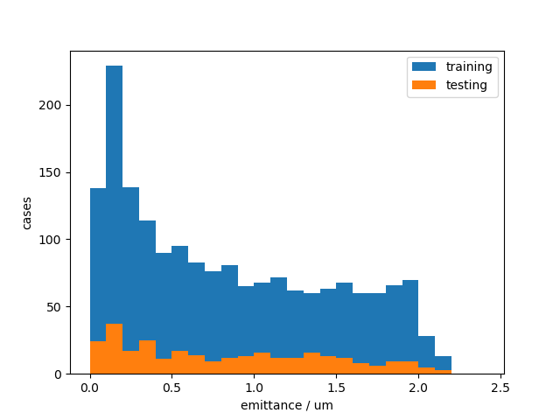
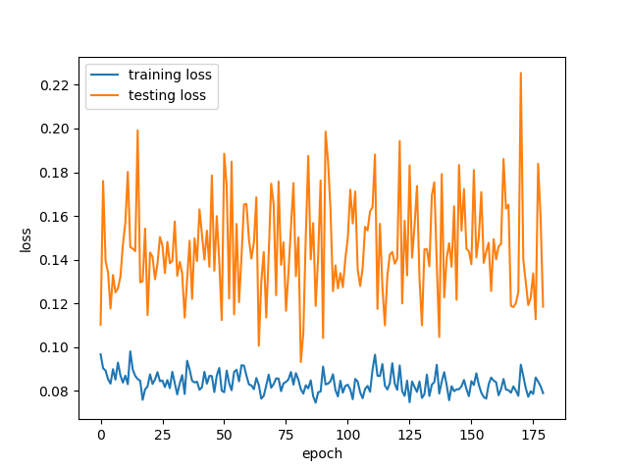
Training and testing
Total cases: 2100 cases, 1800 cases for training and 300 cases for testing.
Loss function: $\frac{1}{N}\sum{\frac{\left|x −y\right|}{(x+y)/2}}$
The relative geometric emittance prediction error is about 15%
11/12
DPG Spring meeting 2021, Dortmund
Shuai Ma | Institute of Radiation Physics | www.hzdr.de

Slide 12
Summary
The image classification network has high accuracy, 98.8%;
The training net work can reduce the noise more effectively and faster than traditional filter;
When the signal-noise ratio is low, the rms calculation has huge error;
The emittance prediction network has been constructed, emittance error is around 15%.
Future work
The emittance prediction network structure should be optimized to reduce the error;
We will test the model in real experiment measurements.
Thank you for your attention!
12/12
DPG Spring meeting 2021, Dortmund
Shuai Ma | Institute of Radiation Physics | www.hzdr.de
Notes:
As a short summary, ……
So we find a network based on our data features, point-clout network.

